Slide 1


Xccelerate.co
Data Science - Tableau Part III
Topics Covered:
Tableau Dashboard/ Story
Extra and more

Slide 2

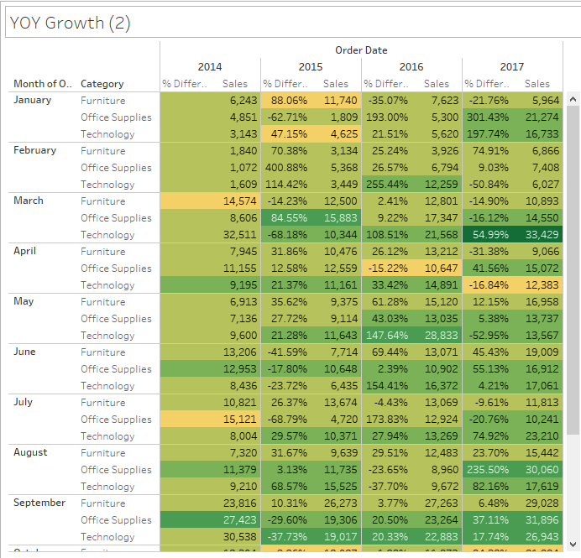
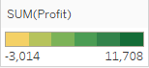
Quick Recap:
Marking skills:
Tooltip = Embedding (嵌入)(2 charts into 1)
Color = Adding a new “dimension”
Color gradient adjustment
Pivot rotating
Filtering by RMB Show Filter
Notes:
https://forms.gle/jnob3YLb33f7Zxcw5 - Feedback form

Slide 3
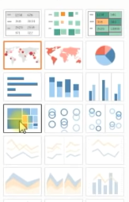
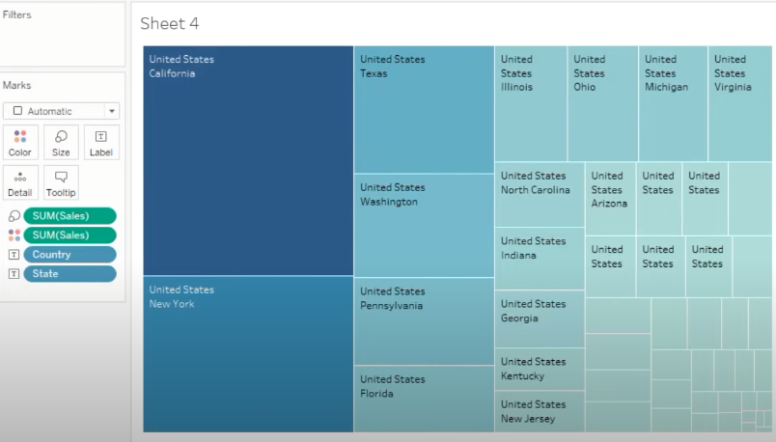
Tableau Geographical Representation 1
Show me feature
Select Sales, State & Country (Hold down Ctrl)
Use treemaps: By clicking on “Show more” -> This icon
This should be one of your outputs :)

Slide 4
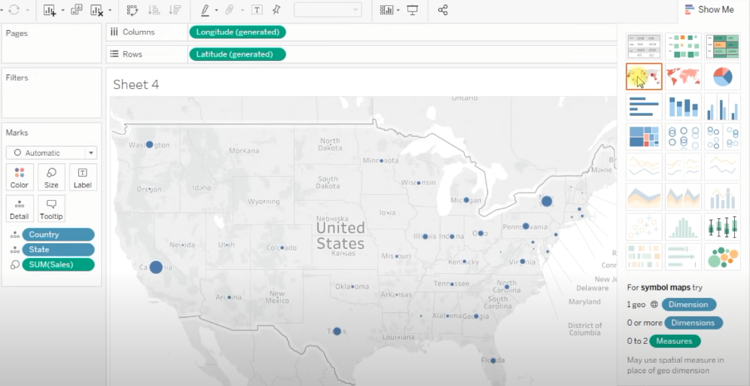
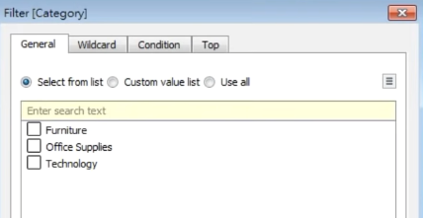
Tableau Geographical Representation 2
Keep the same 3 selected cells
Click “World View” (red arrow)
Note:
All the Columns, Rows
Are generated automatically
Next: Drag Profit and put it in Mark’s Color.
Also: Drag Category and put it in the Filters panel
You should see a pop-up window momentarily

Slide 5
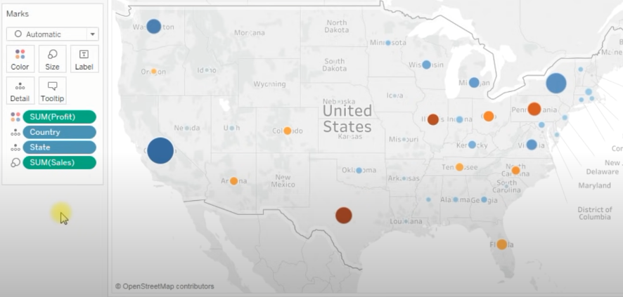
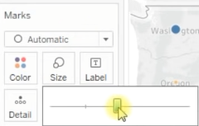
Tableau Geographical Representation 3
Don’t fret, check Furniture and hit OK
Then, on Mark’s panel, select Size and increase the bubbles size
This should be your outcome: You got another finding!
By region/ city the sales of Furnitures

Slide 6
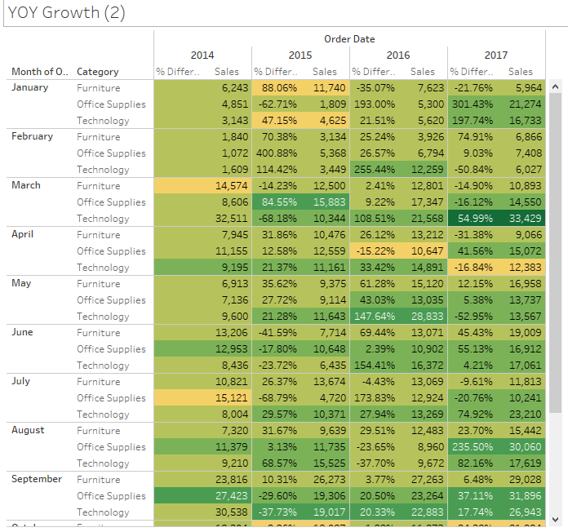
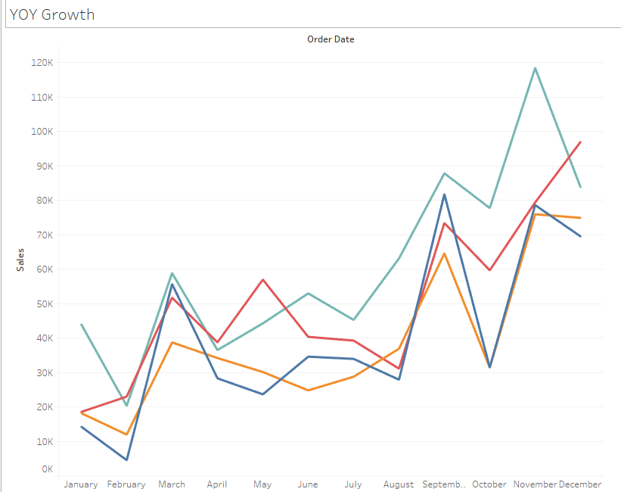
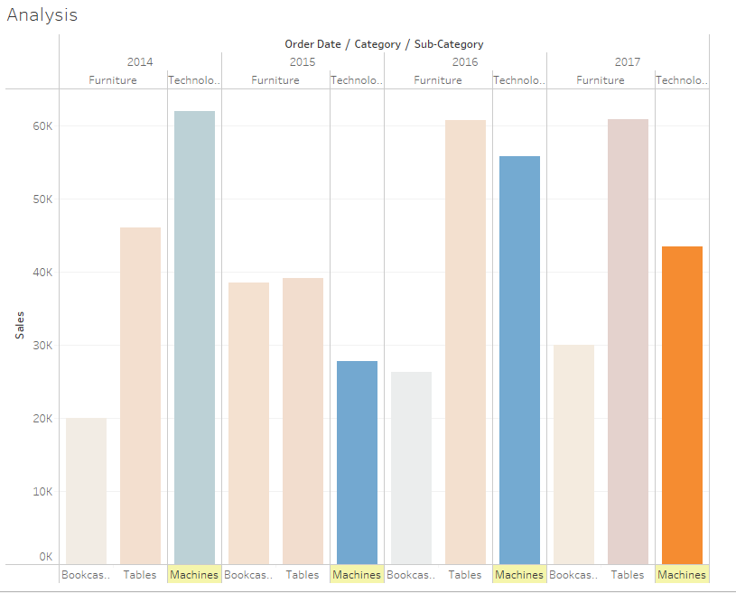
Tableau Dashboard 1
So we made a total of 4 graphs already…

Slide 7

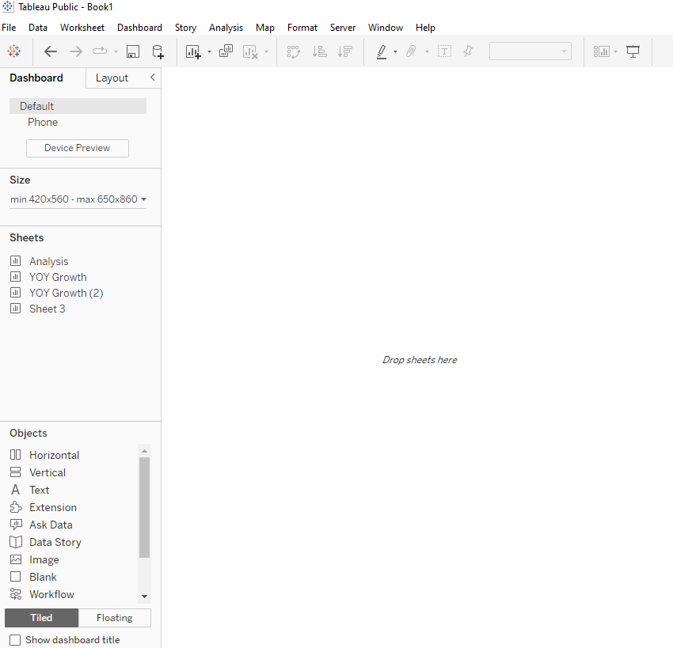
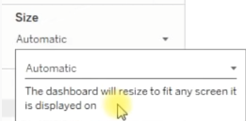
Tableau Dashboard 2
<- Click on this button (Next to your sheets)
To start a new dashboard
(Make sure you keep all your sheets!)
Set Size:
Fixed size -> Automatic
Then… Start dragging your sheets into the window!

Slide 8
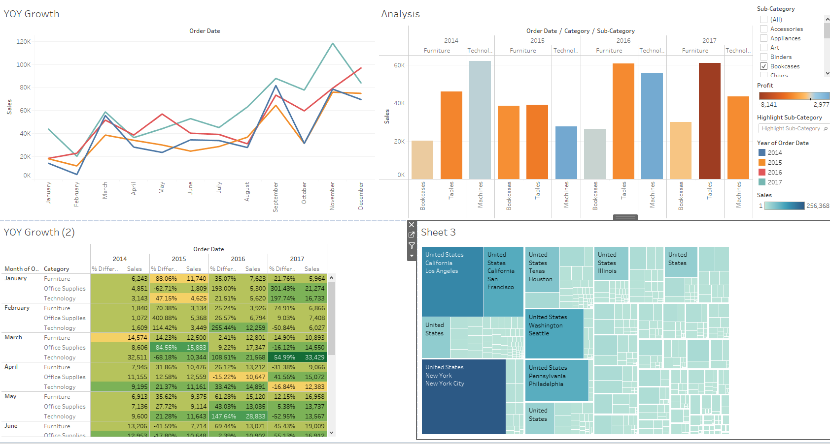
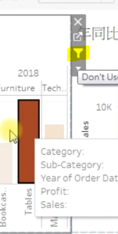
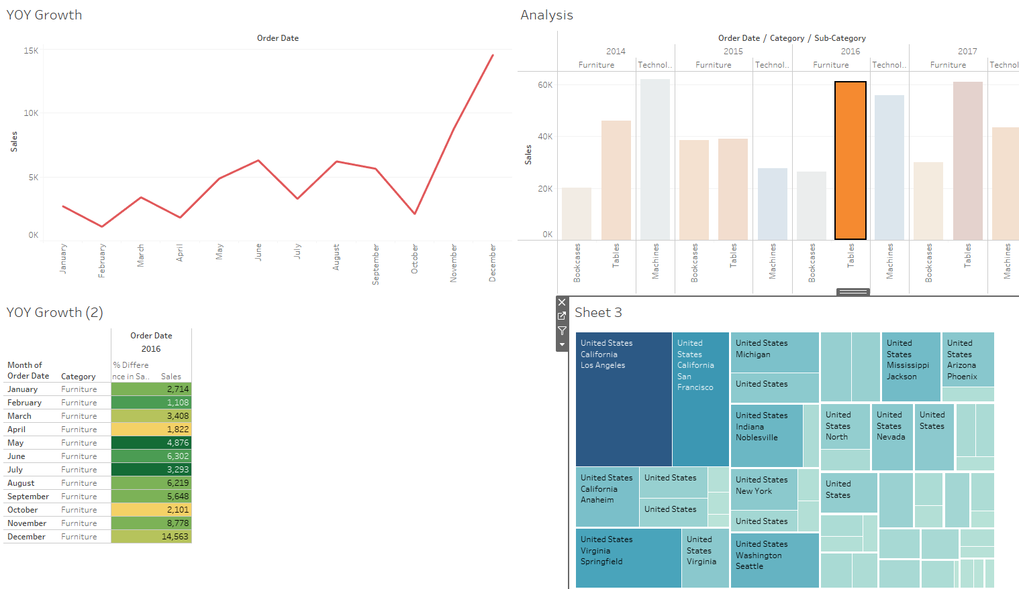
Tableau Dashboard 3
Rearrange the dashboard how you like
Click on the filter icon:
It will rearrange all other tables :)

Slide 9
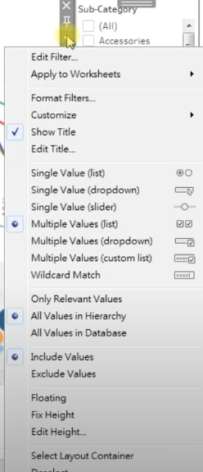
Tableau Dashboard 4
On the Sub-Category drop down menu
Apply to Worksheets (All Using This Data Source)
Sub-Category check the following boxes:
Appliances
Arts
Blinders

Slide 10
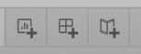
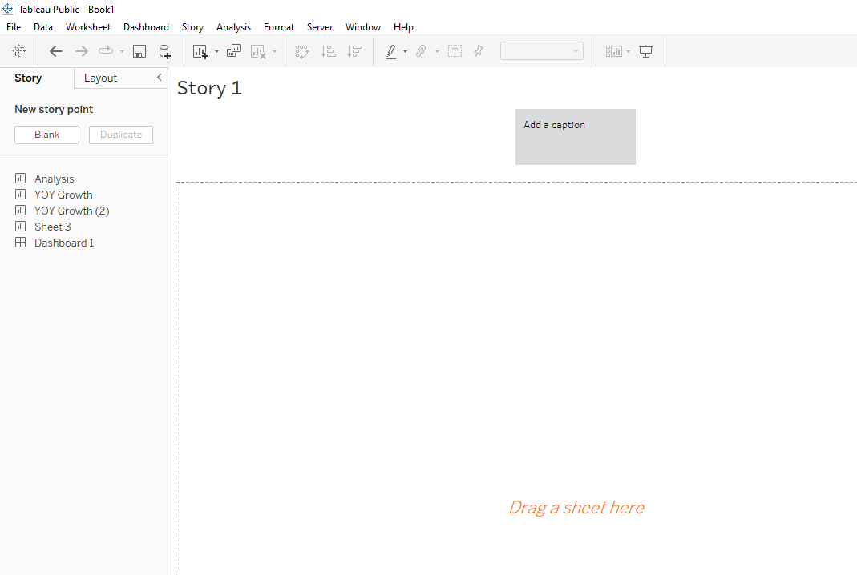
Tableau Story
Click on this to give a powerpoint presentation ish layout
For you to present your data sequentially
Let’s work on more examples learn more about Tableau’s tips

Slide 11

Tableau Tips:
Notes:
https://forms.gle/jnob3YLb33f7Zxcw5 - Feedback form

Slide 12
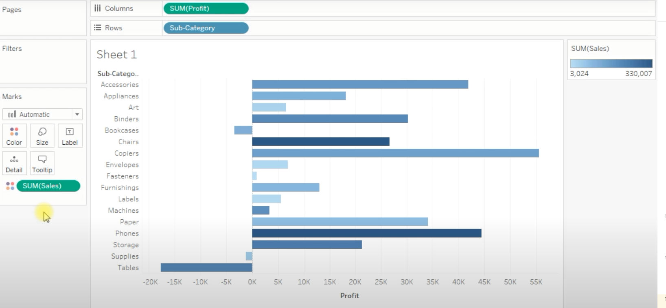
Tableau tips 1:
Keep only feature - Part 1
Use it for sanity checking:
Profit = sales growth
Or vice versa.
Using the same dataset:
Superstore.
Do the following set up first:
Barchart = Automatic
Deeper Color = better sales
Note: Tables has lots of sales but the profit is poor (Hover cursor on it)

Slide 13
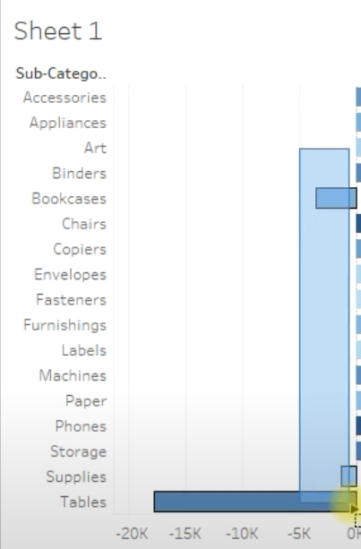
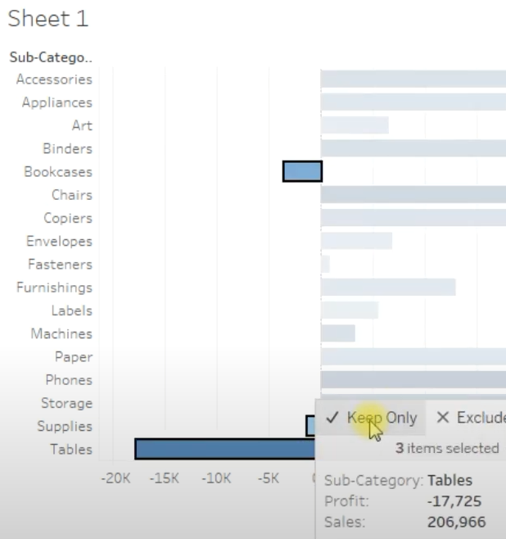
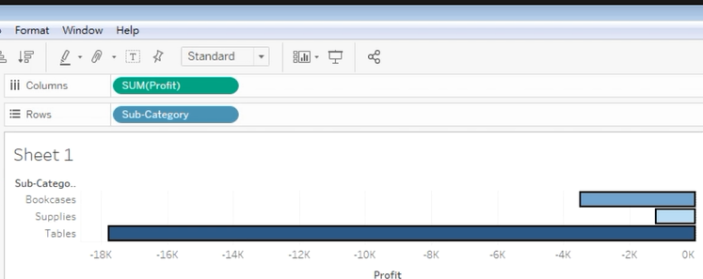
Tableau tips 1:
Keep only feature - Part 2
We need to isolate bookcases, tables, supplies
Due to their underperforming profit
Highlight to select these 3 categories
Hover on either of the 3 bars
Select Keep only
You result will be the following:
Step 1 to 2
Step 2 to 3

Slide 14
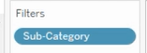
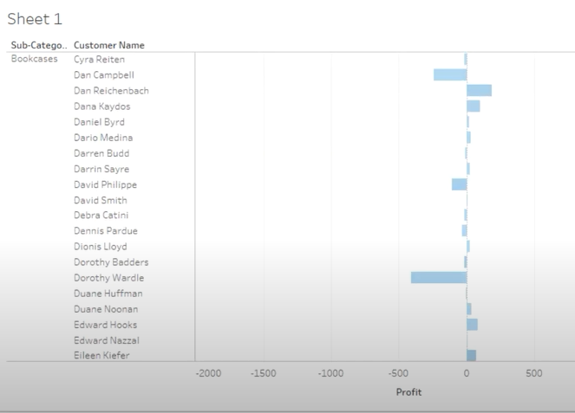
Tableau tips 1:
Keep only feature - Part 3
Notice on your left: Filters has AUTOMATICALLY
Added these 3 sub-categories
Let’s drag Customer name -> Rows:
Click “Add all members”
But there’s no concrete evidence about
Any correlation b/w Customer name &
Categorical items sold
Let’s remove Customer name from Rows

Slide 15
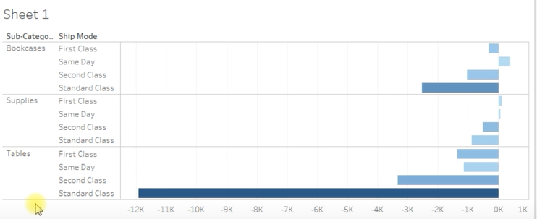
Tableau tips 1:
Keep only feature - Part 4
Instead,
Add Ship Mode (Dimension) into our Rows
New information!
Tables: Perform worse at Standard Classes
To recover more hints/ info from this finding, we can either..
Add in other measures/ dimensions
Use Keep only to isolate/ highlight important information
We’re gonna use Keep only!
At the same time, Ctrl and select ALL of the Standard classes

Slide 16
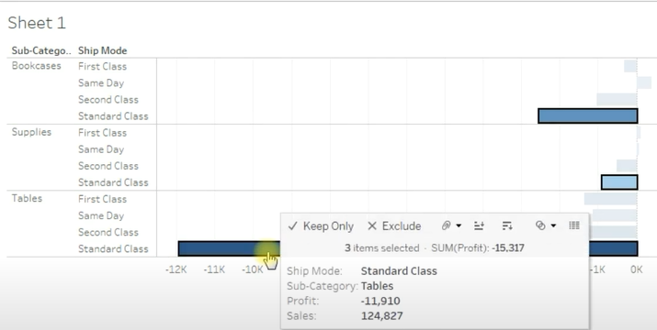
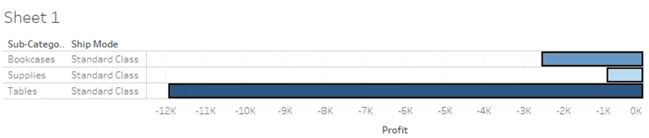
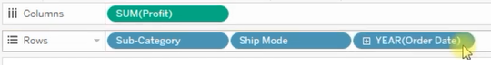
Tableau tips 1:
Keep only feature - Part 5
Click on Keep only
And this should be your output
Next, we want to introduce a time axis to this data!
Drag Order Date into Rows
Marks: Automatic -> Bar
Our final output looks like this

Slide 17
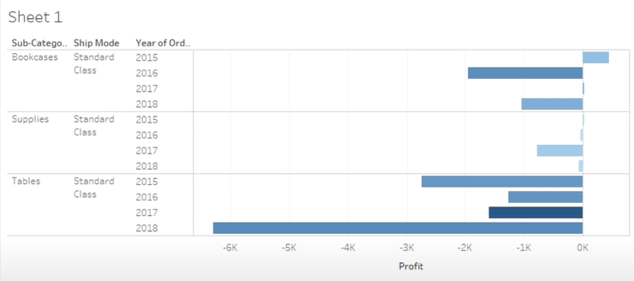
Tableau tips 1:
Keep only feature - Part 6
Please note that there’s no one straight answer
EDA is the majority of what Data Analyst does when Tableau is used

